Slide 1
Voice Conversion

Slide 2
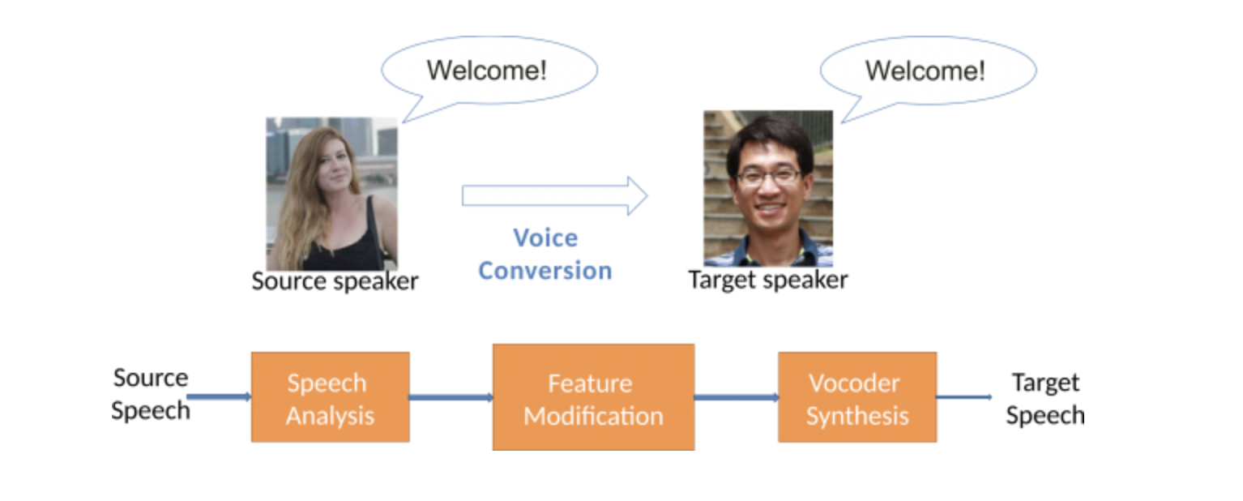
Source: http://ece.nus.edu.sg/hlt/voice-conversion/

Slide 3
Voice Conversion Technology
VAE
Voice Conversion from Non-parallel Corpora Using Variational Auto-encoder
CDVAE
Voice Conversion Based on Cross-Domain Features Using Variational Auto Encoders

Slide 4

ASR + TTS
TTS
A speaker
ASR
B speaker
Words
X-vector

Slide 5
VQ-VAE + TTS
TTS
VQ-VAE
VQ
X-vector

